Slide 1
Pre-Live Session 12
Ben Goodwin

Slide 2
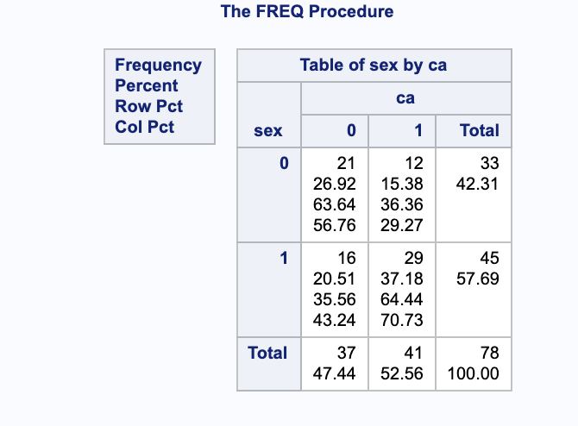
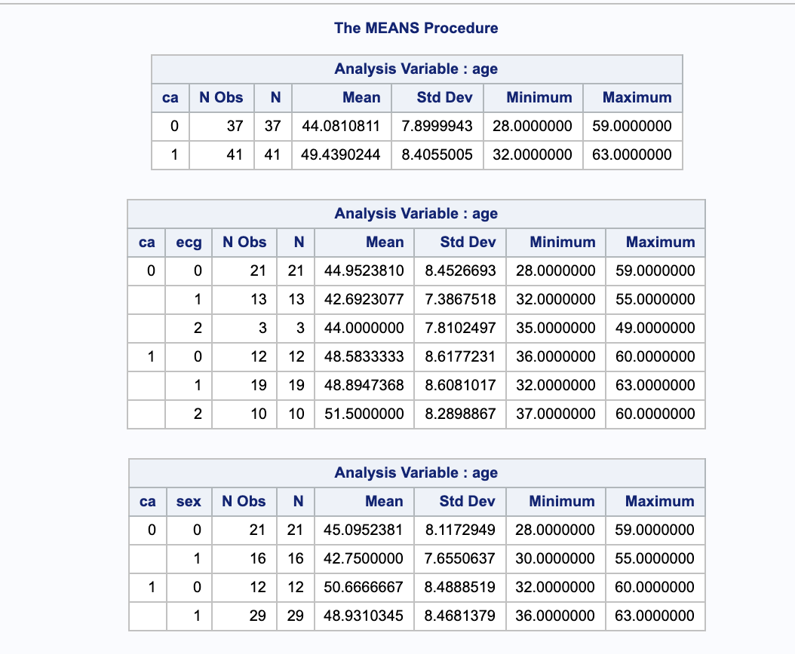
Proc Freq and Proc Means
(Freq Procedure)
(Means Procedure)
Based on the above tables. It seems like that there is at least one group that is different. The tables seem to indicate that males, in general have higher instances of the disease.
There are also more males in the sample, and those males have higher instances of the disease.
In proc mean, we can see that the various tests are all significant, thus indicating that one of the groups shows a difference (at least evidence of one.)

Slide 3
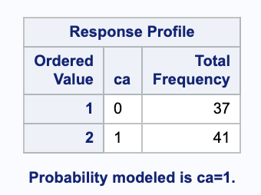
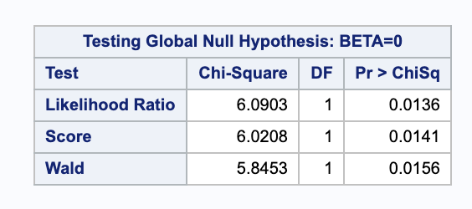
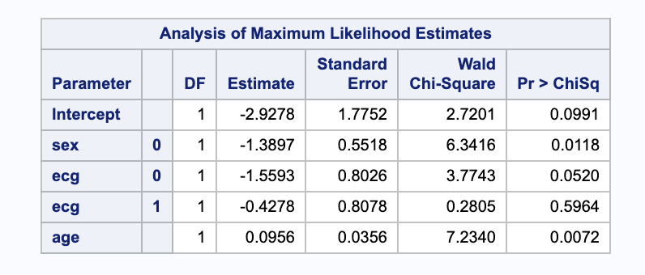
Logistic Regression with Three Predictors
(Response Profile, n =78)
(The chi-square test statistics and associated p-values shown in the table indicate that each of the three variables in the model significantly improve the model fit) Overall model is singificant
The results in this table show coefficients and standard errors.
Sex and age are significant.

Slide 4
Interpretation of the Regression Coefficient for Age
For every one unit change in age, the log odds of coronary artery disease (vs no coronary disease)
increase by 0.0956.
O/R
Exp(0.0956*(45-55))=0.620, or about 2/3. A 55 year old surviving has about 2/3 the odds of a 45 year old
Logit(∏) = -2.9278-1.3897*(1)+0.0956*(50)-0.4278*(1)=0.0347

Slide 5
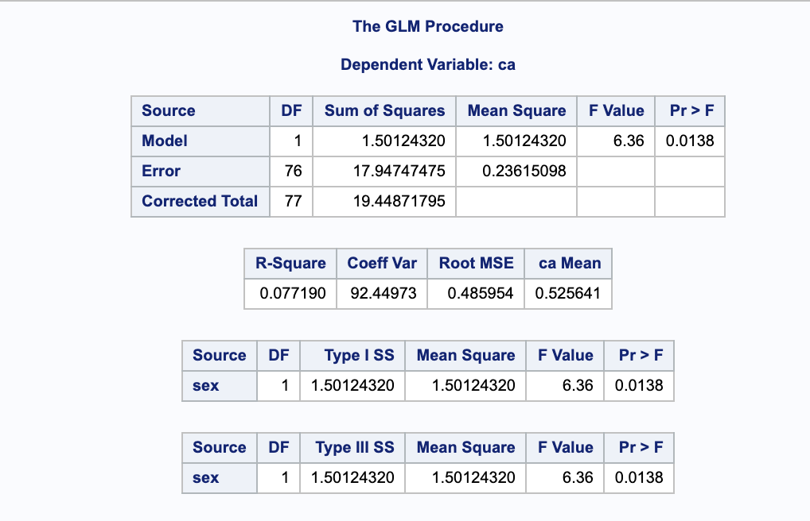
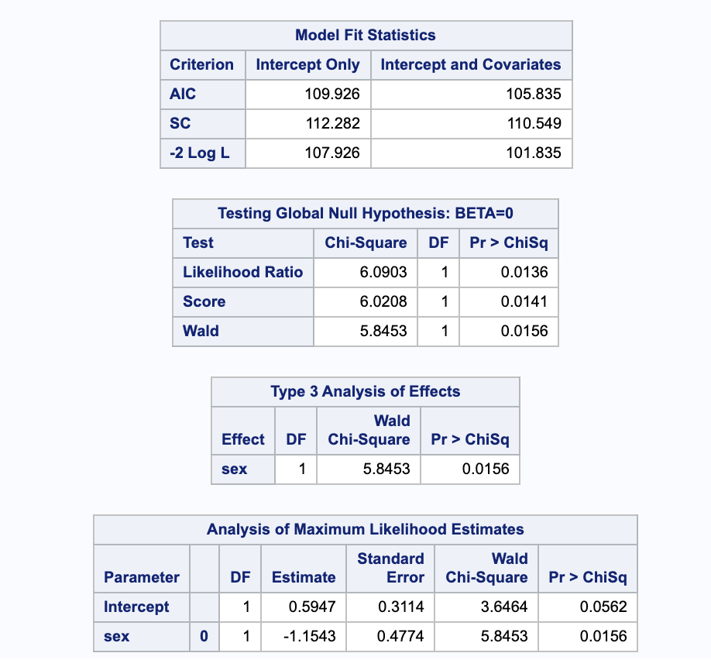
Run a 2x2 analysis with CA and Sex and then run a logistic regression model just using Sex as an explanatory variable
(2x2 ANOVA)
(Logistic Regression)

Slide 6
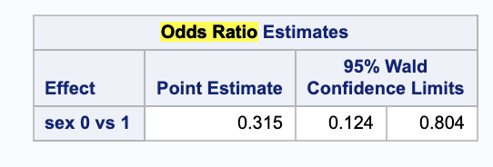
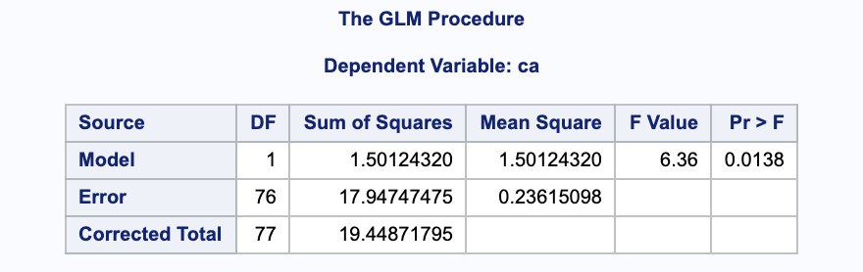
Run a 2x2 analysis with CA and Sex and then run a logistic regression model just using Sex as an explanatory variable
The point estimate of 0.315 (63/200) indicates that females are 1/3 as likely as males to contract the disease.
I had trouble with the odds ratio for the 2x2 Run

